Slide 1
Solidifying SBHC and School Collaboration to Provide Better Patient Care to Students
Kristin Oreskovich
Jamie Duvall
November 9, 2021

Slide 2
Conflicts of Interest
No conflicts of interest.

Slide 3
Learning Objectives
Describe common areas where collaboration can be improved between the schools and SBHCs.
List three reasons for student absenteeism and how SBHC may help address the issue.
Identify opportunities for schools and SBHCs to work together to help students succeed.

Slide 4
Health and Education Go Together
Increased visits to a school nurse for somatic complaints is correlated with lower academic achievement (Ratterman, et al, 2021)
Lower levels of education attainment is a predictor of earlier death (Roy, et al, 2020)
  CARDIA (coronary artery risk development in young adults) study has followed the same cohort of over 5000 people from 1985 to 2017
  Each level of education attainment, I.e., high school or less, some college, college completion, was associated with 1.37 fewer years per life lost

Slide 5
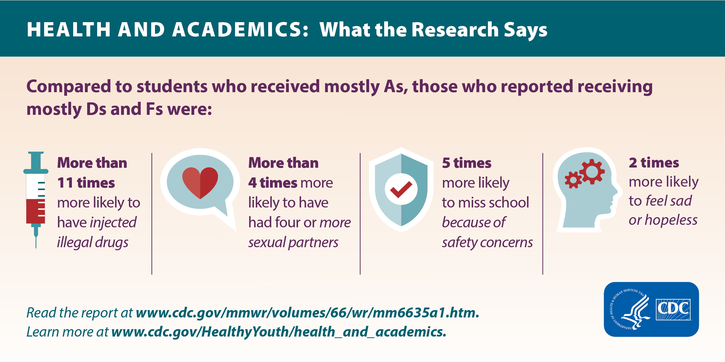

Slide 6
Long and Short-Term Negative Effects of Chronic Absenteeism (Allen, et al, 2018)
Graduation rates
Academic performance
Social functioning
Adult income
Overall health
Life expectancy

Slide 7
Individual Factors Associated with Chronic Absenteeism (Allen, et al, 2018)
Bullying or perceived lack of safety at school
Chronic illness, e.g., asthma, diabetes, obesity
Did not attend center-based pre-school
Disability or special ed.
Exposure to tobacco smoke (for children with asthma)
Exposure to violence
History of frequent absences
Lack of access to medical or dental care
History of poor academic performance
Mental health conditions, e.g., depression, anxiety, ADHD, behavioral problems
Pregnancy or parenthood
Substance use
Sleep deficiency

Slide 8
Family Factors Associated with Chronic Absenteeism (Allen, et al, 2018)
Student has caregiving responsibilities at home
Food insecurity
Health problems in family members
Housing instability or homelessness
Lack of structure or supervision
Parent did not go to college
Parent had negative school experiences
Parent incarcerated
Parent unemployed
Parent works night shift or has multiple jobs

Slide 9
School and Community Factors Associated with Chronic Absenteeism (Allen, et al, 2018)
Cultural barriers
Economic disadvantage
Member of socially vulnerable group, e.g., LGBTQI
Non-white race
School factors, e.g., quality of air, no outdoor space, no school nurse, poor school climate
Unreliable school transportation
Unsafe route to school

Slide 10
SBHC can help students avoid absences and increase academic success
Comprehensive risk screening – which addresses most reasons for challenges with academic success and absenteeism
  Home and School
  Health Behaviors
  Safety and Injuries
  Feelings and Well-being
  Sexual Health
  Substance Use
  Development and Future Plans
Provision of primary care and behavioral health care

Slide 11
School-SBHC Collaboration Survey
SBHC asked a variety of school staff to complete survey
Do school staff know the SBHC is on campus
Do they make referrals to the SBHC
What are the reasons for referrals to the SBHC

Slide 12
Diverse Responses From School Staff

Slide 13
Diverse Responses From School Staff

Slide 14
Awareness of SBHC

Slide 15
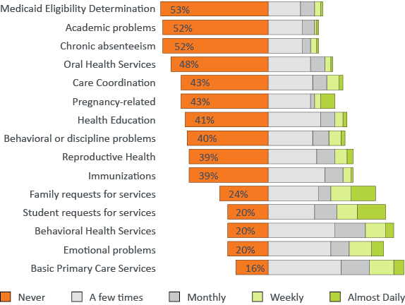
Opportunities to Serve More Students
School staff report “Never” referring their students
to the SBHC for these health services:

Slide 16
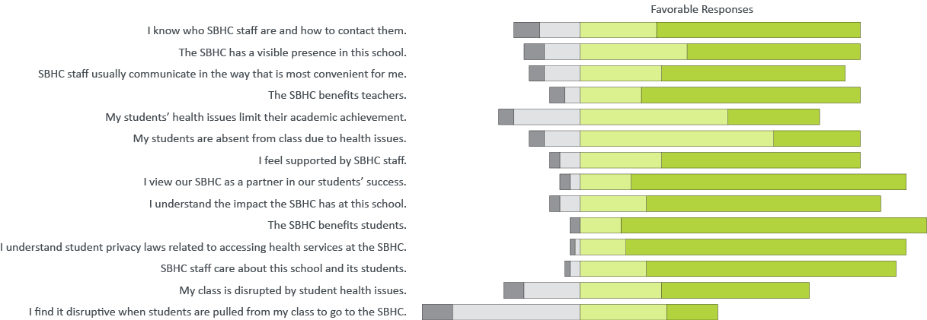
School Staff Perceptions
School staff perceptions of SBHCs are highly favorable.

Slide 17
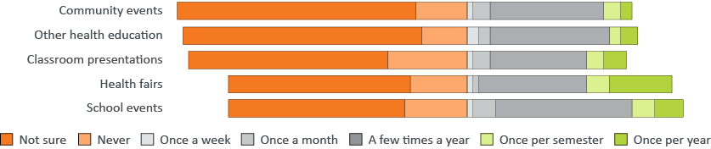
SBHC School Involvement
SBHCs have an opportunity to become more involved at their school.
How often does your SBHC participate in the following school activities?

Slide 18
SBHC Collaboration with School Staff

Slide 19
Working Together to Close the Gap
Collaboration is key and on-going
SBHC - Understand your school community’s needs
Communicate with school staff, have presence at school event – market your SBHC
  Hours of operation
  Services provided
  Referral process
  Best time to pull students
School staff – visit SBHC to find out what they're all about
Remember of that healthy students are more successful learners
“I did not realize that all of these services are provided for our students”

Slide 20
Importance of SBHC and School Collaboration
SBHCs and schools share a common goal: supporting student success in school
The benefits of collaboration are too important for schools and SBHC to not work together on a consistent and regular basis
Higher Adult Income
Better Social Functioning
Enhanced Academic Performance
Better Overall Health
Increased Life Expectancy
Improved Graduation Rates

Slide 21
Questions?

Slide 22
References
Allen, C. W., Diamond-Myrsten, S., & Rollins, L. K. (2018, December 15). School absenteeism in children and adolescents. American Family Physician. Retrieved November 4, 2021, from https://www.aafp.org/afp/2018/1215/p738.html.
Centers for Disease Control and Prevention. (2017, September 7). Health-related behaviors and academic achievement among high school students - United States, 2015. Centers for Disease Control and Prevention. Retrieved November 4, 2021, from https://www.cdc.gov/mmwr/volumes/66/wr/mm6635a1.htm.
Rattermann, M. J., Angelov, A., Reddicks, T., & Monk, J. (2021). Advancing Health Equity by addressing Social Determinants of Health: Using Health Data to improve educational outcomes. PLOS ONE, 16(3). https://doi.org/10.1371/journal.pone.0247909
Roy, B., Kiefe, C. I., Jacobs, D. R., Goff, D. C., Lloyd-Jones, D., Shikany, J. M., Reis, J. P., Gordon-Larsen, P., & Lewis, C. E. (2020). Education, race/ethnicity, and causes of premature mortality among middle-aged adults in 4 US urban communities: Results from Cardia, 1985–2017. American Journal of Public Health, 110(4), 530–536. https://doi.org/10.2105/ajph.2019.305506

Slide 23
Breakout Questions
Do you have a SBHC?
What is your role in the school or SBHC?
How do you currently partner with school nurses, counselors, health assistants, teachers, administration for student health and success?
What can be done at your school to improve health and academic outcomes for students?

