Slide 1
FY24 Pitch for the People:
Expansion and Sustainability of New Mexico School-Based Health Centers
Public Health Division
Kristin Oreskovich
OPA
Arya Showers

Slide 2





Goals
Mission
To ensure health equity, we work with our partners to promote health and well-being, and improve health outcomes for all people in New Mexico.
.
We expand equitable access to services for all New Mexicans
We ensure safety in New Mexico healthcare environments
We improve health status for all New Mexicans
We support each other by promoting an environment of mutual respect, trust, open communication, and needed resources for staff to serve New Mexicans and to grow and reach their professional goals
Notes:
Highlight or put a box around the goals your pitch helps to achieve.

Slide 3

“The future wellbeing of our country depends on how we support and invest in the next generation.” – Vivek Murthy, M.D., M.B.A., U.S. Surgeon General

Slide 4

Meet Jose*
Jose was referred to the SBHC by a teacher because he had a sore throat and a cough
Comprehensive risk screening done by the SBHC identified Jose had also been kicked out of his house, had anxiety, and suicidal ideation
* Based on a real NMDOH client, whose name and photo are changed.

Slide 5
Expansion and Sustainability Request
The NM DOH SBHC program is seeking an additional $7.3M for a total $10M in state general funds to:
Expand hours and services in existing SBHCs
Fund two expansion projects to increase SBHC access for approximately 22,000 students
  13 new locations working on SBHC planning with NMASBHC
  Initiative with Governor’s office to deliver integrated services (primary care and behavioral health) via telehealth and mobile units to approximately 59 additional rural schools
Adequate staff for SBHC Program

Slide 6
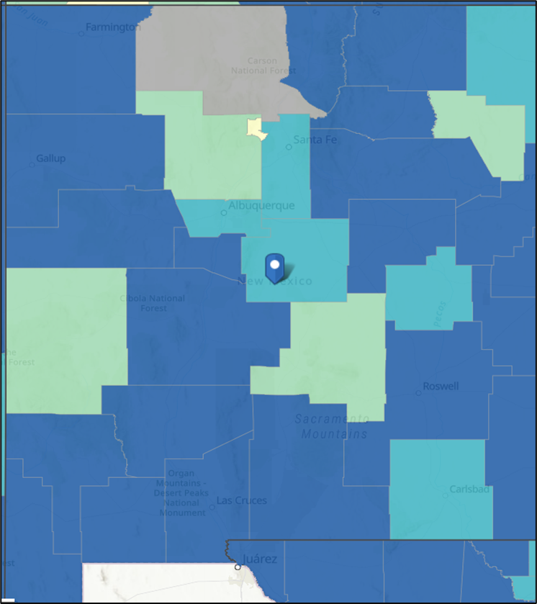


Social Vulnerability
The degree to which a community exhibits certain social conditions, including high poverty, low percentage of vehicle access, or crowded households, may affect that community’s ability to prevent human suffering and financial loss in the event of disaster. (SVI2018Documentation_01192022_1.pdf (cdc.gov)
High vulnerability
Moderate to high vulnerability
Moderate vulnerability
Low Vulnerability

Slide 7
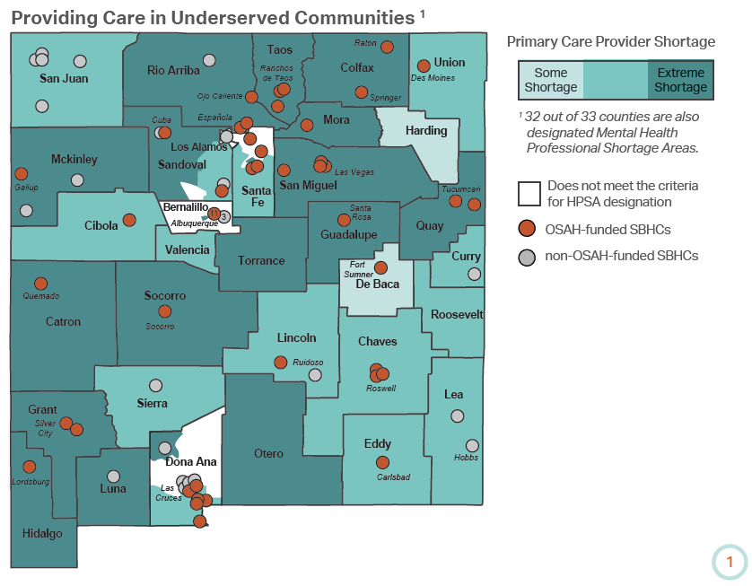
New Mexico Counties with School-Based Health Centers or Expansion Proposals
7
2
4
7
6
SBHC planning grant
Telehealth mobile expansion
6
22

Slide 8
Partnership
OSAH
Funding
Contract with sponsoring health organizations
Sponsoring Health Organizations
Partner with local schools and districts
Provide primary care and behavioral health services
Schools and Districts
Provide clinic space within schools or on campus
Make referrals to SBHC
Technical assistance
Evaluation
Bill Medicaid for services and commercial insurances (if applicable)
Submit data set to OSAH

Slide 9
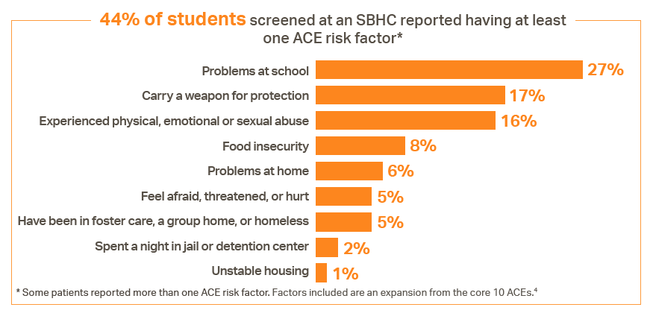
Why Support SBHC Expansion?
Notes:
140,000 New Mexico children lost their primary caregiver during the pandemic.
New Mexico is ranked 49th in child wellbeing
44% of SBHC users report at least one ACE risk factor
Opportunity to expand access SBHC services via telehealth and mobile health in small, rural communities
Improve long-term sustainability SBHC

Slide 10
Impact of Underfunding
Number of OSAH funded SBHC is roughly unchanged in 15 years
Budget cuts result in closing or reduction of SBHC services
From 2006 to present, employees with FTE dedicated to SBHC efforts reduced from 8 to 1.2

Slide 11
Improvements for New Mexicans and NMDOH
Increase access to both primary care and behavioral health care, including suicide prevention and SUD screening
Improve continuity of care through sponsorships with local health care organizations
Increased seat time at school for students and at work for parents
Performance measures:
  Comprehensive risk screening
  Depression screening
  Well-child check
  BMI assessment and counseling
  Chlamydia screening (age appropriate)
  Substance use screening and counseling
  Unintended pregnancy prevention

Slide 12
Stakeholder Engagement – What Users and Providers Think
Sponsoring Organizations
Student Users
11% don’t go anywhere else for care
91% are likely to follow the advice of their SBHC provider
84% have made changes in health risk behaviors because of guidance from the SBHC provider
87% say SBHC providers explain things in a way they understand
SBHC planning grants yielded 18 applications from schools and medical organizations to open new SBHC– 15 funded
6 additional schools inquired that did not submit a full application
4 current SBHC FQHC sponsors are currently planning large telehealth or mobile SBHC expansions to 59 rural schools

Slide 14
SBHC are a Good Investment
Common factors associated with chronic school absenteeism which can be impacted by SBHC include (Allen, et al, 2018):
  Chronic illness
  Bullying
  Mental health conditions
  Substance use
  Pregnancy/parenthood
ROI of NM SBHC
  $1 invested $6 return
USPTF (US Prevention Task Force) found SBHC:
  Economic benefit outweighs costs and saves Medicaid dollars
  Improved health related outcomes and academic achievement
  Improved health equity
Task Force Recommends School-Based Health Centers to Promote Health Equity | The Guide to Community Preventive Services (The Community Guide)
Notes:
The U.S. Preventive Services Task Force is an independent, volunteer panel of national experts in disease prevention and evidence-based medicine. The Task Force works to improve the health of people nationwide by making evidence-based recommendations about clinical preventive services

Slide 15
Leveraging Federal Dollars and Interagency Collaboration
Contract with Human Services Department increases funding for SBHC by adding $0.30 in Medicaid administrative claim for every $1 of General Fund invested in SBHC
Current partnerships that support the access to SBHC for NM children and adolescents
  FQHC
  Hospital systems
  NM Alliance for SBHC
  Apex Evaluation
  MCOs
  HSD
  Behavioral Health Collaborative
  PED
  NMPCA

Slide 16
SBHC COVID Success
During school year 2021-22 El Centro Family Health continued a telehealth hub and spoke model in addition to regular school-based clinic hours to ensure that every student in every school in San Miguel County had access to primary care and behavioral health services. This resulted in 264% (so far) productivity compared to pre-pandemic years.

Slide 17

Jose Tomorrow
Medical provider made a warm-hand-off to the behavioral health(BH) provider
The BH provider and Jose made a safety plan and set up regular visits
Partnering with the school they helped find Jose a place to stay and get him some extra clothes and toiletries
By graduation, Jose no longer had suicidal ideation, was managing his anxiety and was starting a job!
Photo of the family
* Based on a real NMDOH client, whose name and photo are changed.

Slide 18
Questions?
Thank you!

Slide 19
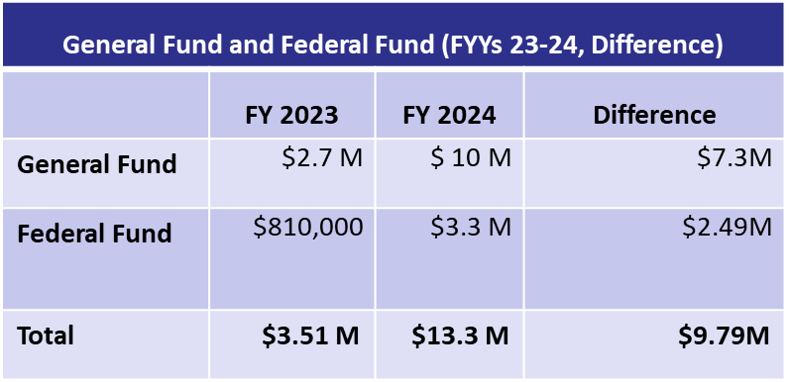
Expansion and Sustainability of New Mexico School-Based Health Centers
Overview
Sustain two current expansion projects
  13 new locations working on SBHC planning with NMASBHC
  Initiative with Governor’s office for expansion of telehealth and mobile integrated services to 49 additional schools
Propose statute to ensure long-term sustainability and consistency of SBHC services
Adequately staff the SBHC Program
7
2
4
7
6
SBHC planning grant
Telehealth mobile expansion
6
22
Return on Investment
$6 ROI for every $1 spent
Increased health equity
Improved health and educational outcomes
Benefits for New Mexicans
Funds will improve the lives of New Mexicans by increasing healthcare access and improving health equity, and health and educational outcomes.

